Slide 1
RADARR ASSIGNMENT
Predicting the impact of tweet that could help Jahanna Chronicle decide if the tweet could go viral or not
GitHub: https://github.com/SachinPathania/Predicting-the-impact-of-tweet-/upload/main
Submitted by:
SACHIN PATHANIA

Slide 2

Dataset Description:
It is a regression problem.
Data set consists of 16 columns including target variable with 50,000 rows.
3 categorical and 13 numerical columns are present.
Challenges faced:
01
Text Analysis Problem
03
non-normalized features
Inference Problem
02

Slide 3
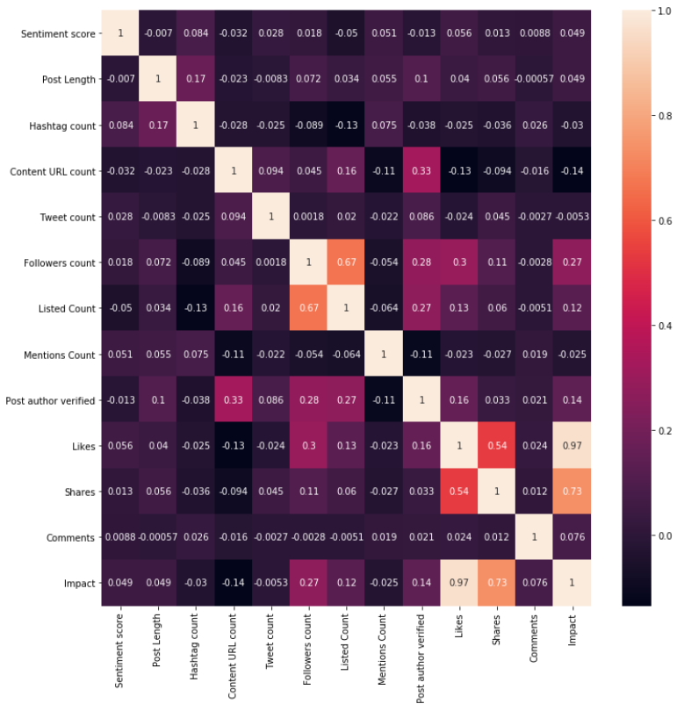
EDA
According to the heatmap it shows that columns : Likes and shares are highly correlated to the Impact which means these columns are playing major role to Predicting the tweet could go viral or not.

Slide 4
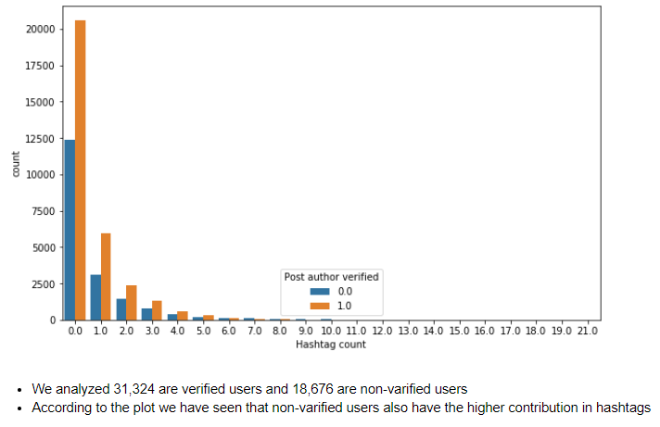
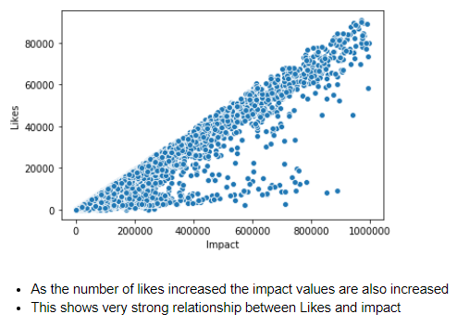
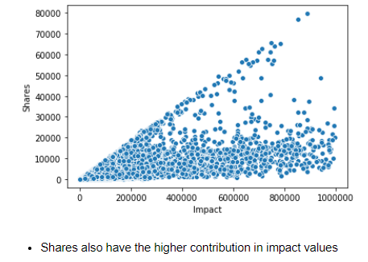
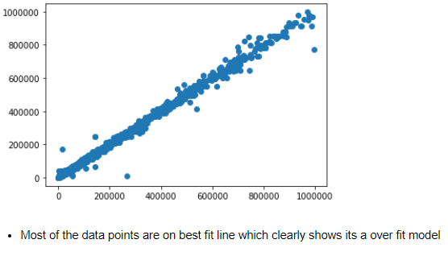

Slide 5
MODELS
1.Linear Regression
Metrics | Training Score
R Squared | 32%
RMSE - mean | 84283.501
Linear Regression accuracy got 32% which means its under fit model
RMSE also got very high 84283.501 (1413.096)
2.Decision tree & Random forest Regression
Metrics/Model | Decision Tree Regressor |  | Random Forest Regressor
 | Train Scores | Test Scores | Train Scores | Test Scores
R Squared | 100% | 99.76% | 99.94% | 99.81%
MAE | 1788.66 | 939.07
MSE | 34724038.70 | 19777658.41
RMSE | 5892.71 | 4447.20

Slide 6

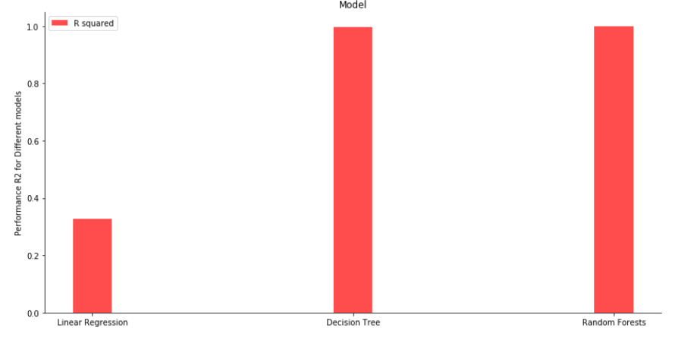
Approach :
Power Transformer for non-normalized features, get dummies for Media Type
Random Forest accuracy was much better as compare to Decision tree and Linear Regression
Random forest is a flexible, easy to use machine learning algorithm that produces, even without hyper-parameter tuning, a great result most of the time.

Slide 7


